Slide 1
Active Shooter
Awareness & Response
at UNT
Presented by UNT Police Department

Slide 2
Content awareness
The topic of Active Shooter is a highly sensitive issue.
Our intent is to educate and prepare our community. If a situation were to occur, our goal is to ensure maximum survival and safety. Points expressed are for that goal, not to shame or judge others.
These tips are generalities and not an all-inclusive list. An active shooter situation contains numerous variables, not all of which can be accounted here.
The content being discussed could be upsetting for some.
Please take time to yourself, if needed.

Slide 3
What we will discuss
Active shooter definition and statistics
Responding to an active shooting
Contacting police/what to expect
Tips for witnesses & bystanders
Risk identification & preventative measures

Slide 4
Definition
Identifiers
Statistics

Slide 5
Active Shooter definition
What: An individual actively engaged in killing or attempting to kill people
Where: In a confined and populated area
How: Typically, through the use of firearms
Timing: Average of 10-15 minutes; situations are often unpredictable and evolve quickly
Sources: Department of Homeland Security, Federal Bureau of Investigation

Slide 6
Active Shooter identifiers
Armed with a deadly weapon
Intends to kill
Accepts targets of opportunity
Moves throughout the building/area until stopped
Focused on harming/killing, not escape
Sources: Department of Homeland Security, Federal Bureau of Investigation

Slide 7
Active Shooter identifiers
The following pages include data from
FBI statistical analyses.
An active shooter may appear different from the identities presented in this data or in the media.

Slide 8
Historic incidents & statistics
FBI data from 2000 to 2019.
Male shooters:
332
Female shooters:
13
Age ranges
Incidents:
333
Number of Shooters:
345
Pre-teen: 2
Teens: 52
20s: 103
30s: 60
40s: 63
50s: 34
60s: 19
70s: 6
80s: 1
Unk: 5

Slide 9
Recent incidents & statistics
FBI data from 2017 to 2021.
2021 active shooter statistics
Ages ranged from 12 to 67
60 males; 1 female
49% apprehended by police
23% killed by police
18% committed suicide
7% killed by citizen at scene
31
61
192 total
2017-21
30
40
30
From 2019 to 2020: 33% increase
From 2020 to 2021: 52.5% increase

Slide 10
Places of occurrence
Types of places where active shootings happened.
FBI data from 2000-20 (left) & 2021 (right).
125
60
45
44
33
28
19
18
15
15
16
4
2
3
3
0
1
1
1
0
Business open to people
Business closed to people
Open spaces
K-12
Govt/
Military
Areas
Colleges/
Universities
Health
Care
House of Worship
Residence
Other

Slide 11
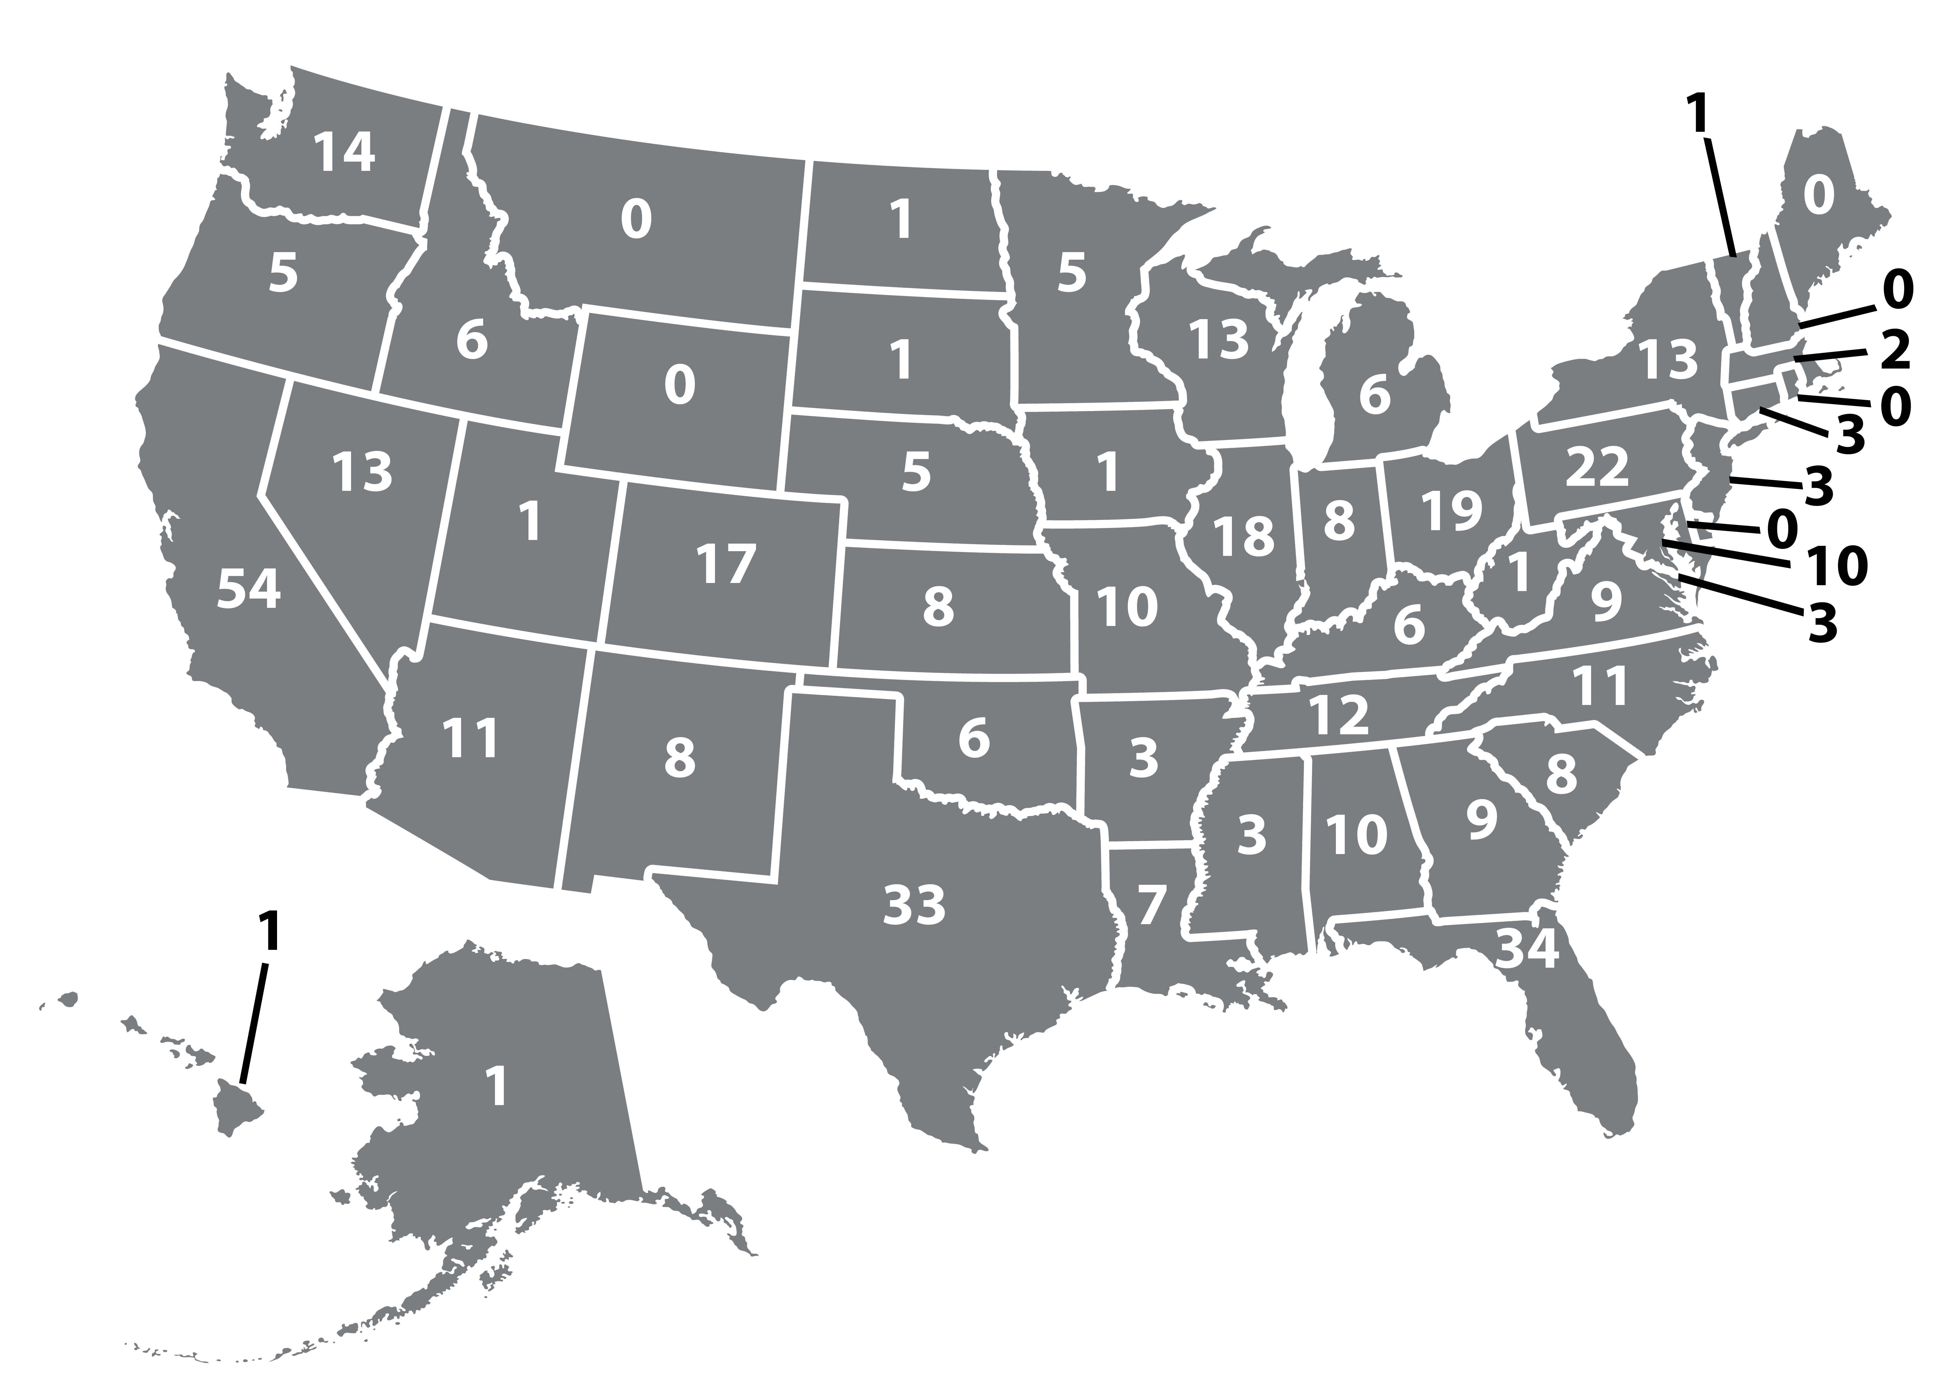
Incidents by state
FBI data from 2000 to 2021
Alabama - 10 Alaska - 1 Arizona - 11 Arkansas - 3 California - 54 Colorado - 17 Connecticut - 3 Delaware - 0 Florida - 34 Georgia - 9 Hawaii - 1 Idaho - 6 Illinois - 18
Indiana - 8 Iowa - 1 Kansas - 8 Kentucky - 6 Louisiana - 7 Maine - 0 Maryland - 10 Massachusetts - 2 Michigan - 6 Minnesota - 5 Mississippi - 10 Missouri - 10 Montana - 0
Nebraska - 5 Nevada - 13 New Hampshire - 0 New Jersey - 3 New Mexico - 8 New York - 13 North Carolina - 11 North Dakota - 1 Ohio - 19 Oklahoma - 6 Oregon - 5 Pennsylvania - 22
Rhode Island - 0 South Carolina - 8 South Dakota - 1 Tennessee - 12 Texas - 33 Utah - 1 Vermont - 1 Virginia - 9 Washington - 14 West Virginia - 1 Wisconsin - 13 Wyoming - 0
Note: some occurred in 2+ states.
Washington, D.C. - 3

Slide 12
Response Preparedness
Actions and Steps
Discussion of Run, Hide, Fight

Slide 13
Response actions
0. Recognize there is Danger!!
Run
Hide
Fight
Run, Hide, Fight may not happen in that order.

Slide 14
Recognizing danger
Earbuds/headphones may muffle sound
Different guns have different sounds
Guns fired indoors may sound unfamiliar
This video includes sounds for comparison

Slide 15
Recognizing your reaction
Fight, Flight, or Freeze
Studies show those who froze were injured more often.
These skills may help un-freeze.
Sensory expectations
Sounds: gunfire, screams, alarms
Visuals: flashing lights, injuries
Physical: water sprinklers, pushing
Empower yourself
Take action: may give a sense of control
Focus on response: Run, Hide, Fight
Avoid: negative/worst case thinking

Slide 16
Run - advanced preparation
Do this when you enter a room or area.
Consider what route you might take.
Consider your options – windows, doors, stairs, etc.
Prepare now
Floor plans on Emergency Management’s app & website
Mean Green Ready App in Apple Store or Google Play
https://emergency.unt.edu/
emergency-floor-plans

Slide 17
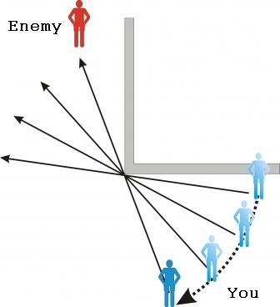
Run – making the decision
Consider the shooter’s location.
Do not evacuate if you could become a target.
Do not run into the unknown.
Do what is best for you, even if others choose not to evacuate.
Less visibility
Greater visibility

Slide 18
Run – follow through
Leave your belongings. Your life is most important.
Consider how to safely help those with disabilities and help others evacuate if you can do so safely.
Do not stop to treat the wounded if shooter is still active, try to make note of their location.
Get to a safe place to call 911.
If you encounter police, do not run up to them or interfere. Keep your hands visible. Follow their instructions.

Slide 19
Run – discussion
What would you do?
1. How would you leave the room you are in right now?
2. As you evacuate, you get to a hallway with several people wounded. You do not hear sounds in the immediate area. You know the area where you just came from is safe. What do you do next?

Slide 20
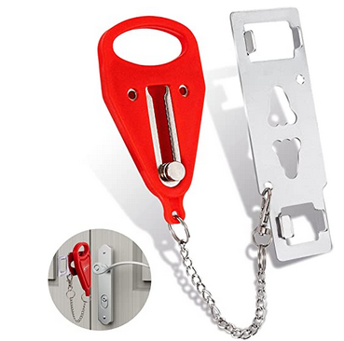
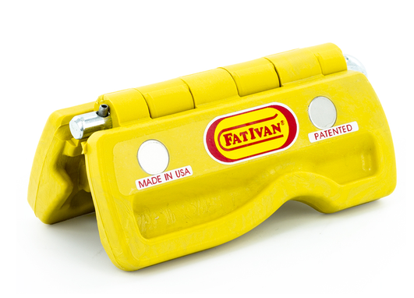
Hide - advanced preparation
Do this when you are in a room or area.
Consider options for hiding – closets, under desks, etc.
Consider options for reinforcing doors/windows.
Consider how doors/windows lock in the areas you use.
We don’t recommend secondary locking devices. They don’t allow law enforcement entry and may not be ADA compliant.

Slide 21
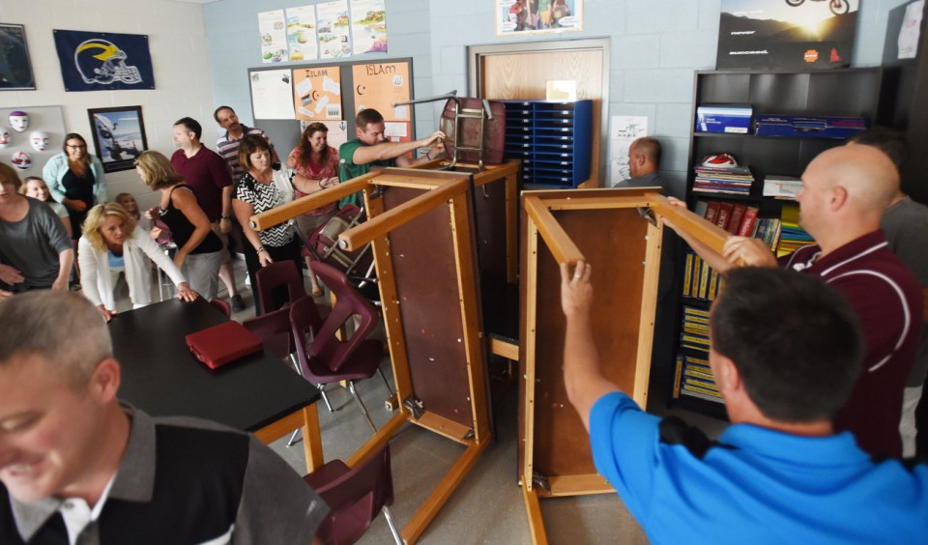
Hide – making the decision
If not in a secure place, find the nearest safe location.
Lock the door, if possible.
Block the door with heavy items.
Turn off lights, if possible.
Stay out of sight, away from windows or doors.

Slide 22
Hide – follow through
Try to stay calm. Stay as quiet as possible.
Silence electronic devices. Turn off vibrating settings.
If shooter is nearby, don’t turn off lights while they can see.
Avoid looking at phone in a dark room. Hide it from view.
In Denton County you can call or text. Include type of emergency & location. Do not use emojis.

Slide 23
Hide – discussion
What would you do?
1. If you had to hide, what would be the first action you’d take in your current room?
2. What resources do you have to help you slow or stop the shooter from entering?

Slide 24
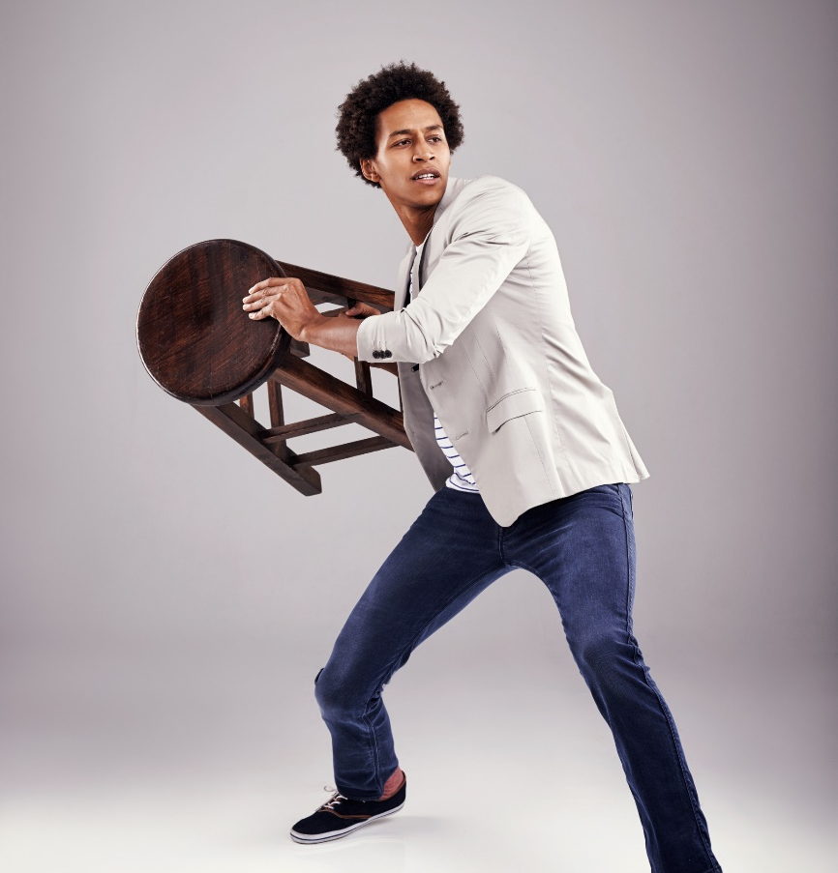
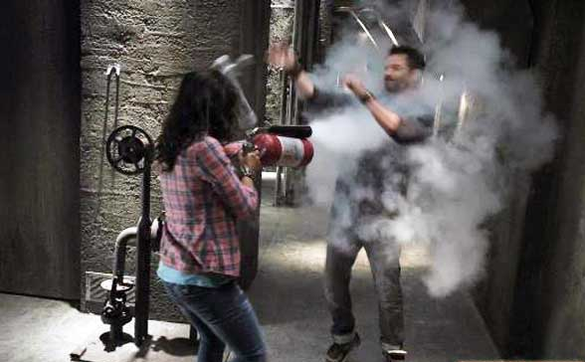
Fight - advanced preparation
Think about this in advance.
If you don’t know if you could fight:
Would you be good at distraction?
If you think you could fight:
What items in the room could be used as weapons?

Slide 25
Fight – making the decision
Only when your life is in imminent danger.
If you must do this, commit to it 100%.
Have the mindset: “I am going to win and go home.”
Be aggressive and attack with a plan.
2000-2021
434 total incidents
Source: FBI
15 armed citizens
shot active shooter causing injury or death
36 citizens fought & successfully detained active shooter until police arrived

Slide 26
Fight – follow through
Distraction team
Fight team
Throw items at shooter.
Interferes with accurate shooting.
Gives others time to react.
Natural reaction for shooter is to move/look away.
Use weapons to stop shooter.
Pens, belts, scissors, shoes, etc. can all become weapons.
Remove shooter’s weapons.
Use force on force.
Act with confidence.

Slide 27
Fight – discussion
What would you do?
1. If you were going to distract a shooter what would you throw that is near you right now?
2. If you were going to fight, what are could be used as weapons that are available to you right now?

Slide 28
Outdoors considerations
Try to determine where the shots are coming from
Remove yourself from the “kill zone”
A safe escape via the most direct possible route
The longer you take it increases your chances of becoming a target
Consider cover and concealment
Cover offers protection from bullets
Concealment helps you remain out of sight but offers little or no protection from bullets

Slide 29
Tips for Witnesses
Police Interactions
Bystander Assistance

Slide 30
Be a good witness
A good description can help distinguish
an innocent person from the active shooter.
These basics are a start
Think: “Top/Down” for better description
Height
Race
Gender
Hat
Glasses
Hair color
Shirt color
Frame/build
Pants color
Shoe type
Unique Identifiers

Slide 31
Calling 9-1-1
What you need to know beforehand
Be thorough
Specific info helps police prepare
It’s OK to repeat info
Others may call 911 but don’t assume that means police have enough info
911 may get busy
Keep trying to call as long as it’s safe to do so
UNT has dispatchers
Let 911 know you’re at UNT so they can send you directly to our team

Slide 32
Calling 9-1-1
Locations
Location of incident
Your location
Shooter(s)
Number of shooters
Description of shooter(s)
Shooter’s route or direction
Type of weapons used
About you
Name
Phone number
Victims
Number of victims
Injuries (to you and others)
Your role at UNT
Deaths
Questions you might
be asked.
These may
be asked quickly since the situation is urgent.

Slide 33
When law enforcement arrives
What you need to know beforehand
They may seem rude
Police may bark orders so that they can get the area cleared
Your hands are important
Police want to see empty hands, clearly visible with fingers spread
Your calm is appreciated
Sudden movements may seem threatening; when you calmly follow directions it helps police
The threat comes first
Police need to focus on stopping the shooter so please don’t stop them to ask for help

Slide 34
When law enforcement arrives
#1 Priority: Stop threat
Even if the shooter is dead, police may need time to be sure the shooter doesn’t have a partner and that the scene is clear/safe
Police presence may vary
You may see one officer or a team, in uniform or not – all should have badges visible
Other responders are nearby
Firefighters and EMTs may wait to treat wounded until police have cleared the scene

Slide 35
When law enforcement arrives
Individuals carrying firearms (LTC/permitless carry)
If you decide to engage the shooter, holster your weapon once the threat is contained and keep your hands fully visible. You don’t want responding officers to believe you are the shooter. Once the threat is contained, stay with them, do not continue clearing the building.

Slide 36
Bystander help
If it’s safe to do so, here are some skills to
help victims until first responders arrive

Slide 37
Bystander help
UNT Emergency Management
offers preparedness courses
Until Help Arrives
Steps to take to help victims until first responders arrive
Stop the Bleed
Specific training on how to help stop life-threatening, bleeding injuries
To schedule a course and view others,
sign up at https://emergency.unt.edu/training-0

Slide 38
Risk Identification
Preventative Measures

Slide 39
Risk identification
While most active shooters share similar demographics, there is not one profile that fits all.
There also is not one sure warning sign or
a definite checklist or algorithm.
However, it may be possible to prevent an attack with threat assessment & management strategies.

Slide 40
Risk identification
Source: FBI study of pre-attack behaviors, 2000-2013
62%
Had history as an abuser or bully
40%
Bought firearm legally for attack
Had connection to the attack site
Already had a firearm
73%
35%
Spent a week or more planning
Made threats prior to attack
77%
55%
Had trigger event prior to attack
Of those, made threats in person
44%
95%

Slide 41
Risk identification
Source: FBI study of pre-attack behaviors, 2000-2013
Lived with someone or had significant in-person
or online social interactions
100%
Recognize new/worsening behavior
Starts pulling away
Threatening or intimidating act, gesture or statement
Fixated on a hate group, terrorist or extremist person/material
Suicidal statements/behavior
Has abnormal life stress such as:
mental health, financial strain, job-related, friend or partner conflict, drug/alcohol-related, etc.

Slide 42
Risk identification
Other areas of concern
Unhealthy coping skills or conflict resolution
Unhealthy response to rules, authority
Narcissistic, entitled, injustice “collector”
Preoccupation with violence
Abnormal need of attention, recognition
Deceptive and/or manipulative

Slide 43
Risk identification
Threat communications to consider
Context
Threat or frustration?
Leakage
May be said to third-party
Pattern of escalation
Intensity of effort
Personalized motive
Justifying violence
Pattern of communications
May try to act as if joking
May say to those who “understand”
“If I had a gun, they’d be sorry”
“I’m going to kill them tomorrow”
“Don’t come to class tomorrow but watch the news”

Slide 44
Risk identification
In general, active shooters move along an identifiable path.
Real or imagined grievance or humiliation
Feels a need for revenge or justice
Feels need for notoriety or recognition
Researches and plans attack
Develops desire to kill and/or be killed
Cannot perceive better way to solve problem
Begins actual preparation for attack
Breaches area
Attacks

Slide 45
Preventative measures
UNT CARE Team is for non-emergency issues
If you suspect a student, staff, or faculty member may want to harm themself or others
If they have concerning texts, posts on social media or used disturbing language but threat does not seem immediate
The team provides resources to help address the comprehensive needs of an individual with resources at UNT and in the community.
Send email with details to report.unt.edu

Slide 46
Preventative measures
UNT Police has a non-emergency number
If you notice suspicious activity or behavior but it does not seem immediately dangerous.
Trust your instincts if something doesn’t “feel” right.
People aren’t necessarily suspicious but behavior is – someone trying to hide their face, someone looking into multiple cars or trying doors, someone hiding and watching others, etc.
UNT PD non-emergency: 940-565-3000

Slide 47
Preventative measures
Contact 988 for suicide and crisis issues
Operates 24/7 providing resources for those experiencing thoughts of suicide, mental health issues, substance use crises or other emotional distress.
You can also call if you know of a loved one who is experiencing a crisis.
Call or text 988 nationwide

Slide 48
Preventative measures
Contact 911 for emergency issues
If there is a chance of immediate harm, such as a person with a weapon or making an immediate threat
You or others are facing a life-threatening danger
If a crime or fight is currently happening
Call or text 911 in Denton County

Slide 49
Preventative measures
Workplace & Home
Be aware of who is entering/exiting.
Talk to your coworkers, roommates, family about who is and isn’t allowed.
Be aware of your surroundings.
Know your exits and routes.
Be prepared by asking yourself “what if” – and walking through what you would do.

Slide 50
Preventative measures
Workplace
Surveillance of entries/exits
Access control
Territorial reinforcement
Have open door meetings
Keep personal items (bags, backpacks, etc.) secure
Notify police prior to meeting with a high-risk person

Slide 51
Emergency alerts and information
Other safety programming
Connect with UNT Police

Slide 52
Alerts and information
Eagle Alert
Campus wide emergency alert system. If your number changes, go into your student account to change it there. Alerts for weather and school closures, as well as emergencies.
Crime Alert
Campus wide alert sent through email and/or Eagle Alert (depends on timing). Also posted on police.unt.edu. Only for specific offenses as outlined in the federal Clery Act.
Crime Log
60-day log of crimes and fire-related incidents kept as public record and can be views at police.unt.edu. Lists info such as crime, location, date, etc.

Slide 53
Safety programming at UNT
Presentations
Events
Social media
Invite us to your group. We can discuss theft prevention, securing your area and more.
We hold events on campus such as the Safety Fair, and regular programs about preparedness.
Find us at
@UNTPolice for safety tips and more!

Slide 54
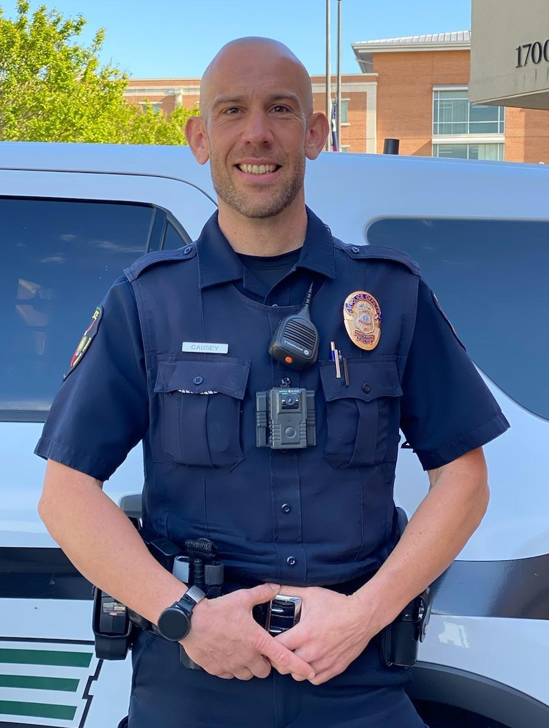
Cpl. David Causey
is the Community Relations officer for UNT Police Department. He is an alumnus of UNT and has been with the department since 2011.
Reach out to him to schedule a training presentation or for more information.
David.Causey@unt.edu
940-369-7691

